Slide 1



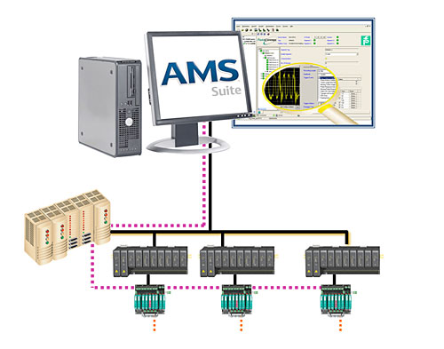

Evolution of the process view
Wisdom
PV
Knowledge
Abnormal Situation Prevention
Analog
Communication
Digital Communication
Diagnostic Information
4-20
mA
1950
1960
1980
2000
2009
Notes:
The view of process has evolved over years. It all started with reading the PV with 4-20 ma signals.
It was a great technology change at that point in time but as the customer needs grew, HART was introduced.
Hart paved way for easy configuration but was limited to PV measurements.
Emerson’s Hart configuration tools are popular in our customer base even today.
In late 1990’s Emerson was a pioneer in introduction PlantWeb architecture which revolutionized the way the process variable was seen.
It was no more just PV that was being seen from a field device. HART pass through and Foundation fieldbus provided the knowledge of the process variable and its state.
In late 2000’s Emerson introduced the device alerts all the way to the HMI level irrespective of whether it is HART or Ff or Wireless HART, providing the operations team with the wisdom and insight into the process.
It has created opportunity for increased availability and performance excellence through Abnormal Situation Prevention.

Slide 2
Is your Control Room here?
Abnormal Situation Prevention
Wisdom

Slide 3
Wisdom to make Productive Decisions
Visit us at the
Control Room Session
At PWoC Seminar
On Feb 17, 2012
At Taj Palace Hote, New Delhi
Wisdom
Abnormal Situation Prevention

